Slide 1
Dirty COW: the kernel's copy-on-write race
A read-only private map must never change the file behind it. A kernel race broke that rule.
fd = open("/zzz", O_RDONLY) /* no write right */
map = mmap(fd, PROT_READ, MAP_PRIVATE)
pwrite("/proc/self/mem", data, addr)
madvise(map, MADV_DONTNEED) /* repeat */
/* the kernel loses the private copy */
We run as seed (UID 1000)
Kernel bug: file bytes change
Nothing here opens the file for writing - the race is inside the kernel's copy-on-write code (CVE-2016-5195).
Notes:
Member 6 - Dirty COW (CVE-2016-5195).
Member 5's race was inside a root-owned program; this one is inside the kernel itself.
Walk through the four lines, then switch to the live demo.

Slide 2
Live demonstration
/zzz belongs to root, mode 0644. Seed can read it - but never write it.
1
2
3
Show the file is protected
Normal copy-on-write
Run the race
cat /zzz shows the original. echo > /zzz: Permission denied.
./cow_control changes its private copy only - the file stays the same.
bash run_trial.sh dummy 30 demo - it stops itself when /zzz changes.
If the race misses this time, the next slide shows the recorded 9 October run.
Notes:
Live demo in the SEED VM as seed (VM: ISSD-Member6-SEED12).
Prep script already created /zzz before class - see Member6/live-demo/DEMO_SCRIPT.md.
Type the six commands slowly; every one is on the demo cheat-sheet.

Slide 3
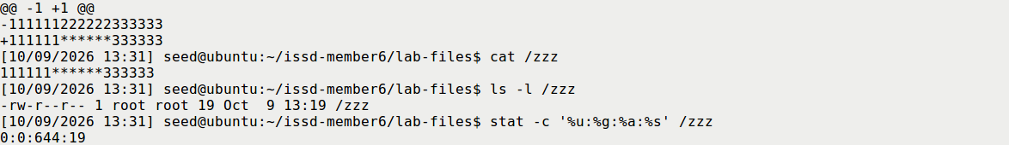
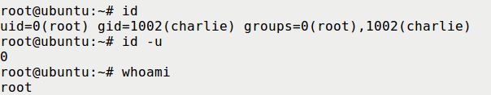
Result: file changed, then uid 0
Task 1 - seed rewrote the root-owned file /zzz (recorded)
Task 2 - charlie's UID 1001 -> 0000; fresh login without sudo gives uid 0
Recorded 9 Oct 2026 - one bounded 30 s run each, 0 s elapsed.
First su attempt failed, retry succeeded. After the demo the account was restored to UID 1001.
Notes:
Both are real runs from 9 October (evidence retained with hashes).
Task 1: whole file became 111111******333333, root:root 0644 kept.
Task 2: only the four UID digits changed; id -u printed 0, whoami root.

Slide 4
Countermeasures
PATCH THE KERNEL
STAY UPDATED
LIMIT & MONITOR
Fixed 2016
Update
Watch uid 0
Upstream fix landed in October 2016.
A fix only helps when the fixed kernel is actually running.
Fewer local users, fewer chances to race.
Supported distros ship it. Our VM keeps the old kernel to demo the bug.
Update and reboot. Retire end-of-life releases like this 12.04 VM.
Baseline /etc/passwd; alert on new UID-0 entries and strange logins.
Private memory must stay private - the kernel fix is the real defence.
Notes:
Four defences: patch, update, limit, monitor.
Deleting the spare template slides was this member's job as the last presenter.

